Slide 1
MS Intouch preview

Slide 2
Introduction
This project is a comprehensive and feature-rich chat application built using Flutter and Firebase.
It offers a secure and seamless user experience by incorporating email and OTP-based authentication, ensuring that only verified users can access the platform.
Once logged in, users can send and receive friend requests, chat in real time, and create or join groups to have collective discussions.
The app also includes a dynamic status feature where users can upload and view temporary updates like images, videos, or text.
To enhance usability, the app supports theme customization and provides an option for chat backup, ensuring that users don’t lose their data.
Overall, the app is designed with a strong focus on privacy, scalability, and user-friendly interaction.

Slide 3
Project Objectives
Build a secure chat app using Flutter and Firebase.
Enable user sign-up/login with OTP verification.
Implement friend requests, group creation, and group chat.
Add support for status updates, theme switching, and chat backups.

Slide 4
Tools and Technologies
Flutter for front-end app development
Firebase for Back-end
Firebase Auth for secure login/signup
Firestore Database for real-time database
Cloudinary for media storage
Provider for state management
Dart as the programming language

Slide 5
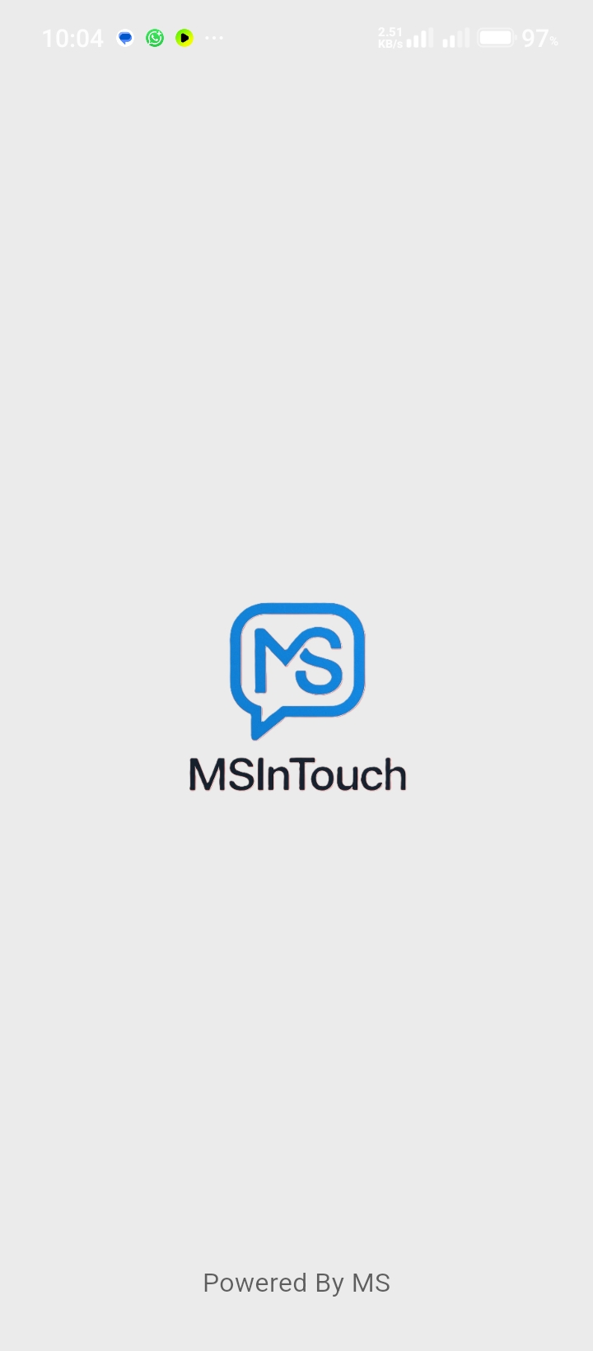

Splash SCreen
Displays the app logo briefly on startup to enhance branding.

Slide 6
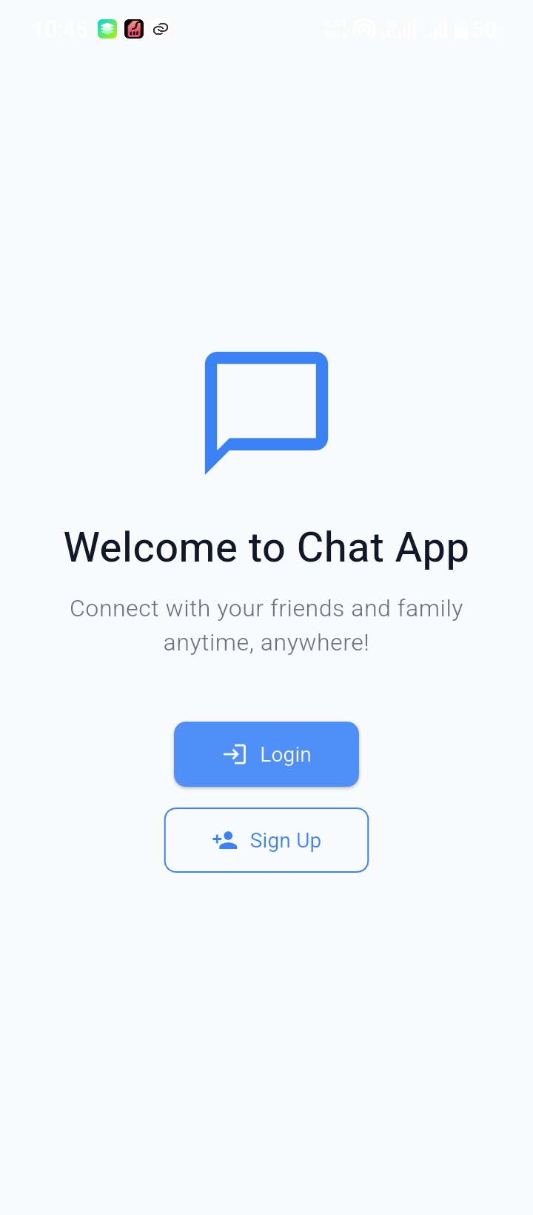
Welcome SCreen
Greets users and offers options to log in or sign up.

Slide 7
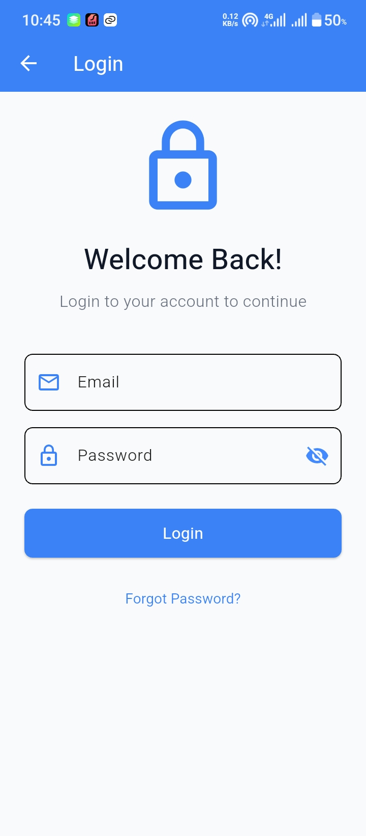
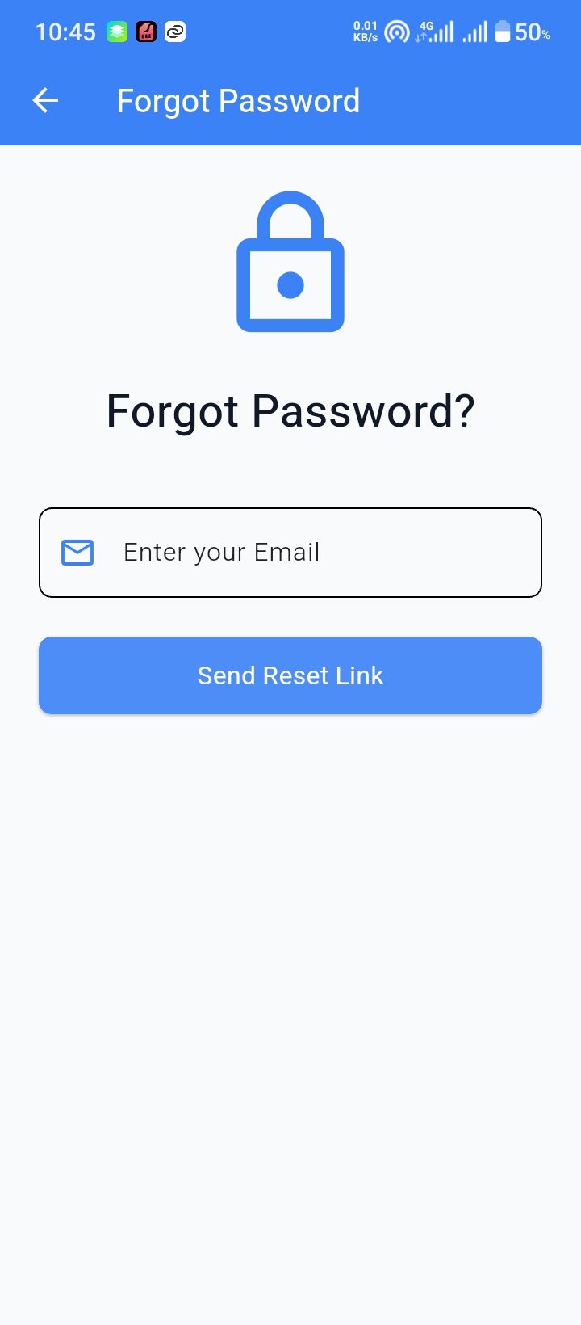
Login SCreen
Allows registered users to enter email and password to access their account.

Slide 8
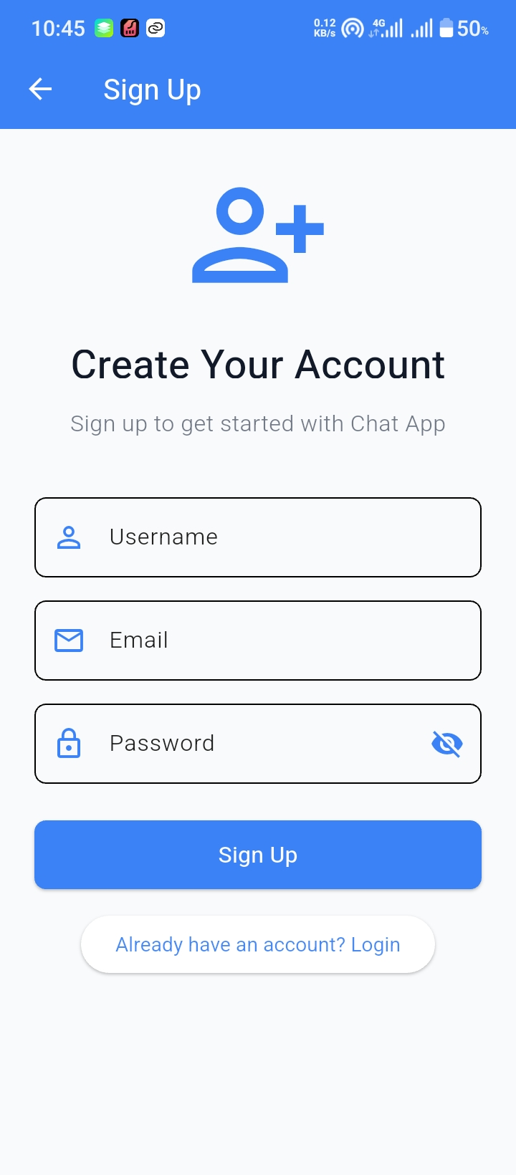
Sign up SCreen
New users can create an account by providing basic details.

Slide 9
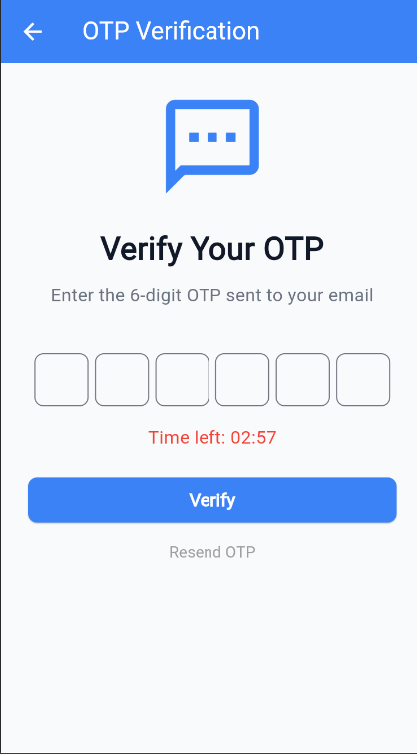
Otp verification SCreen
Validates the user’s email by entering the OTP sent to their inbox.

Slide 10
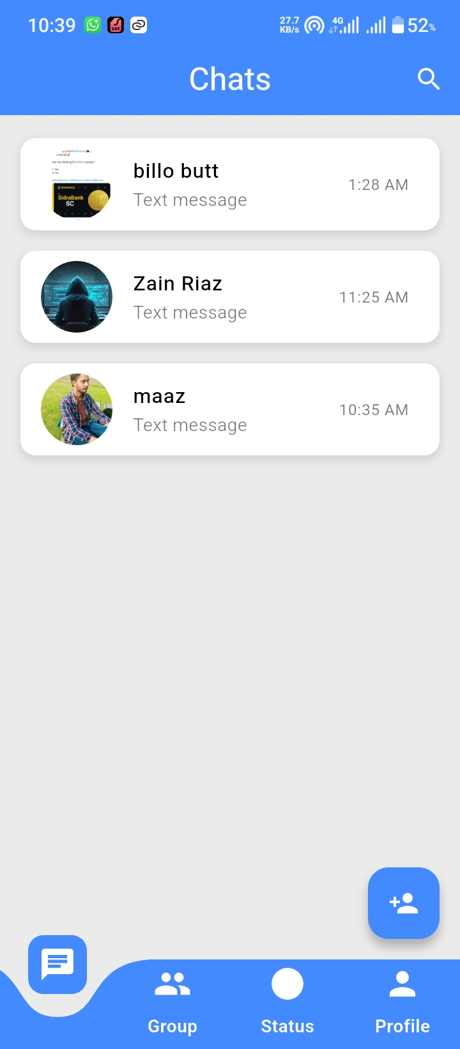
Home Screen
Displays recent chats, online friends, and access to main features.

Slide 11
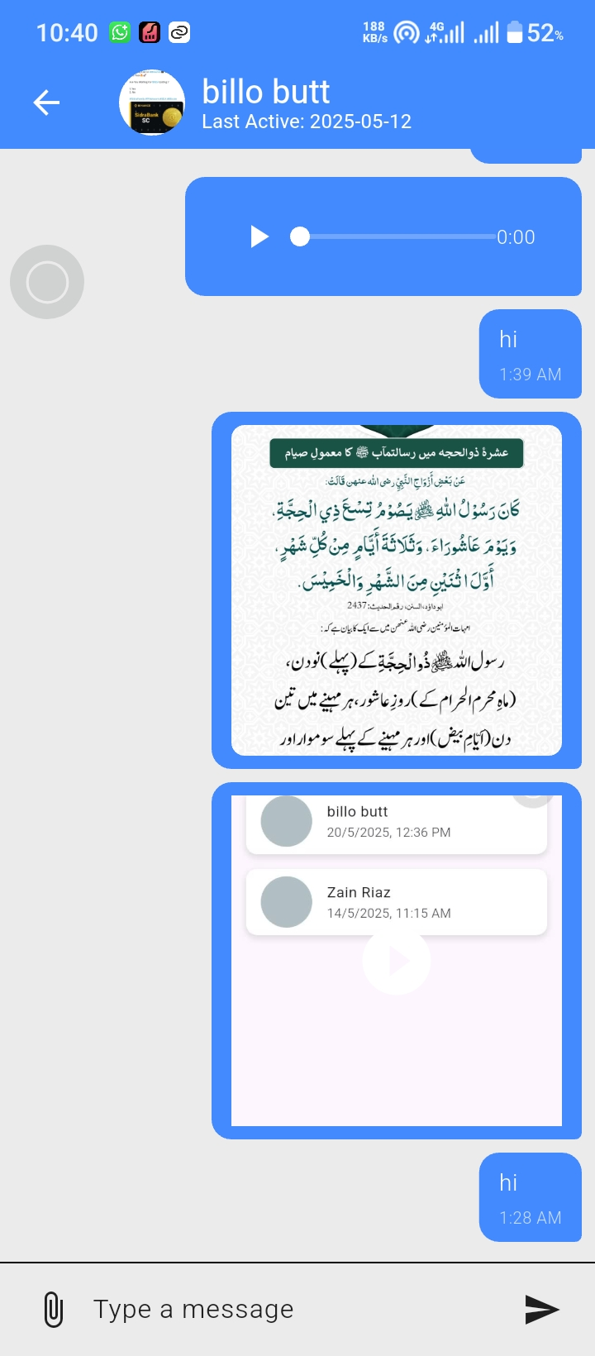
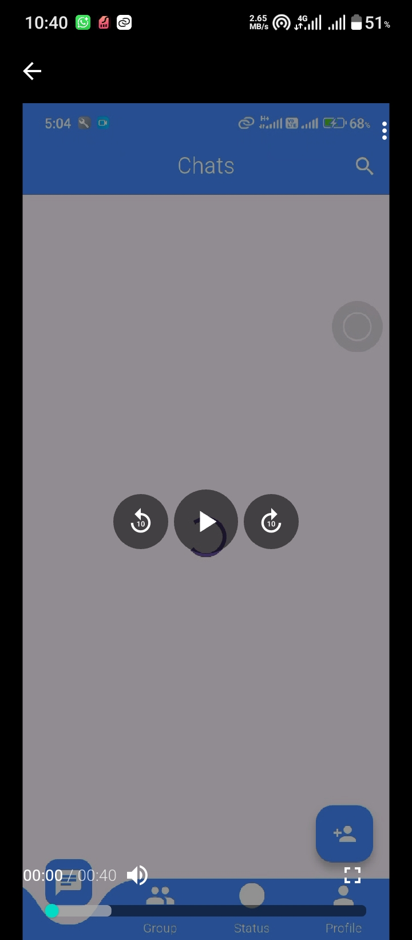
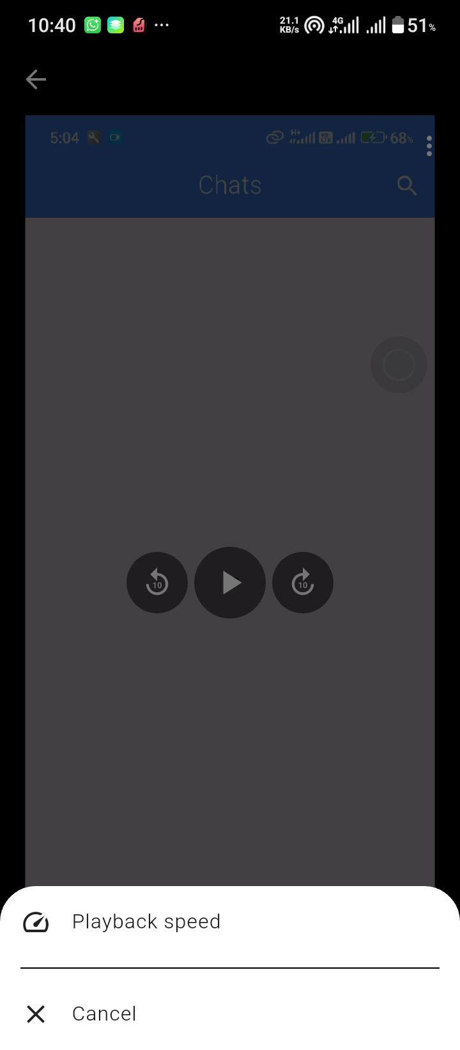
Friend Conversation Screen
One-on-one chat view with a selected friend, showing messages.

Slide 12
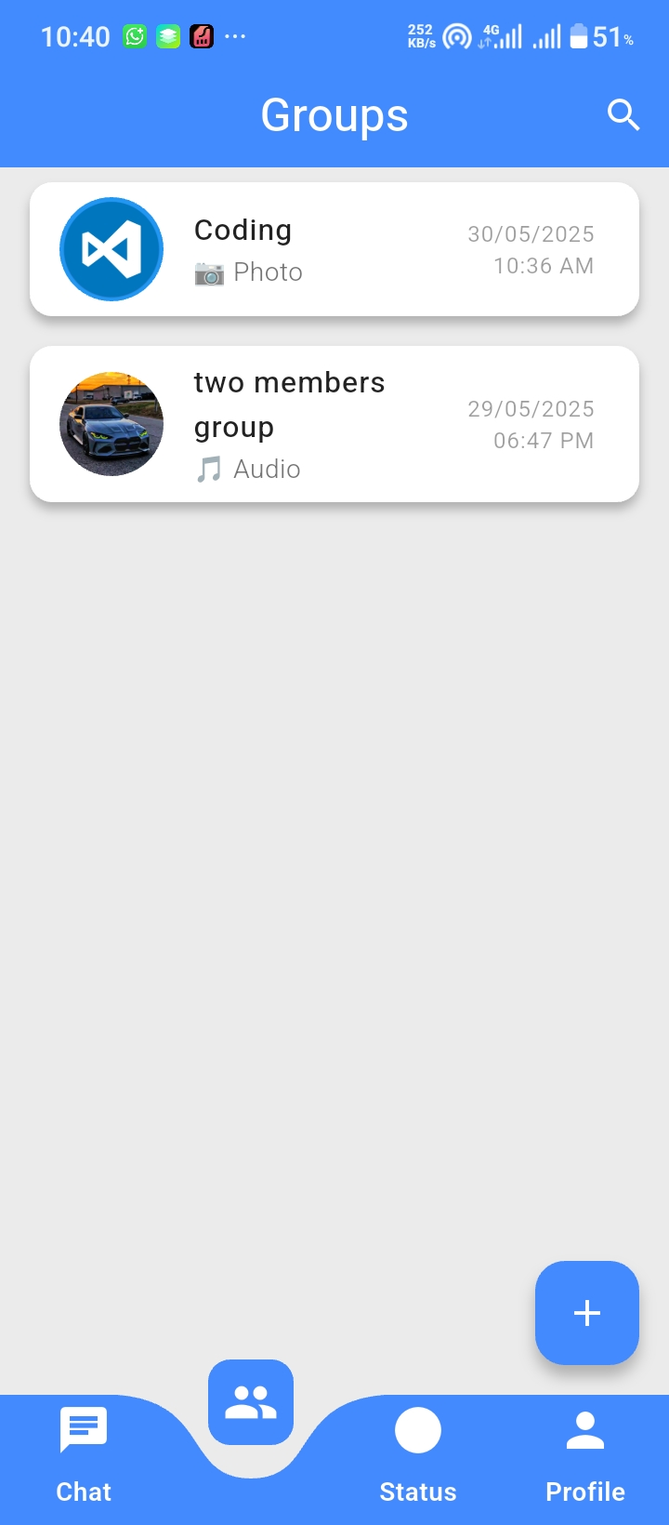
Group Screen
Allows users to view, join, or create group chats.

Slide 13
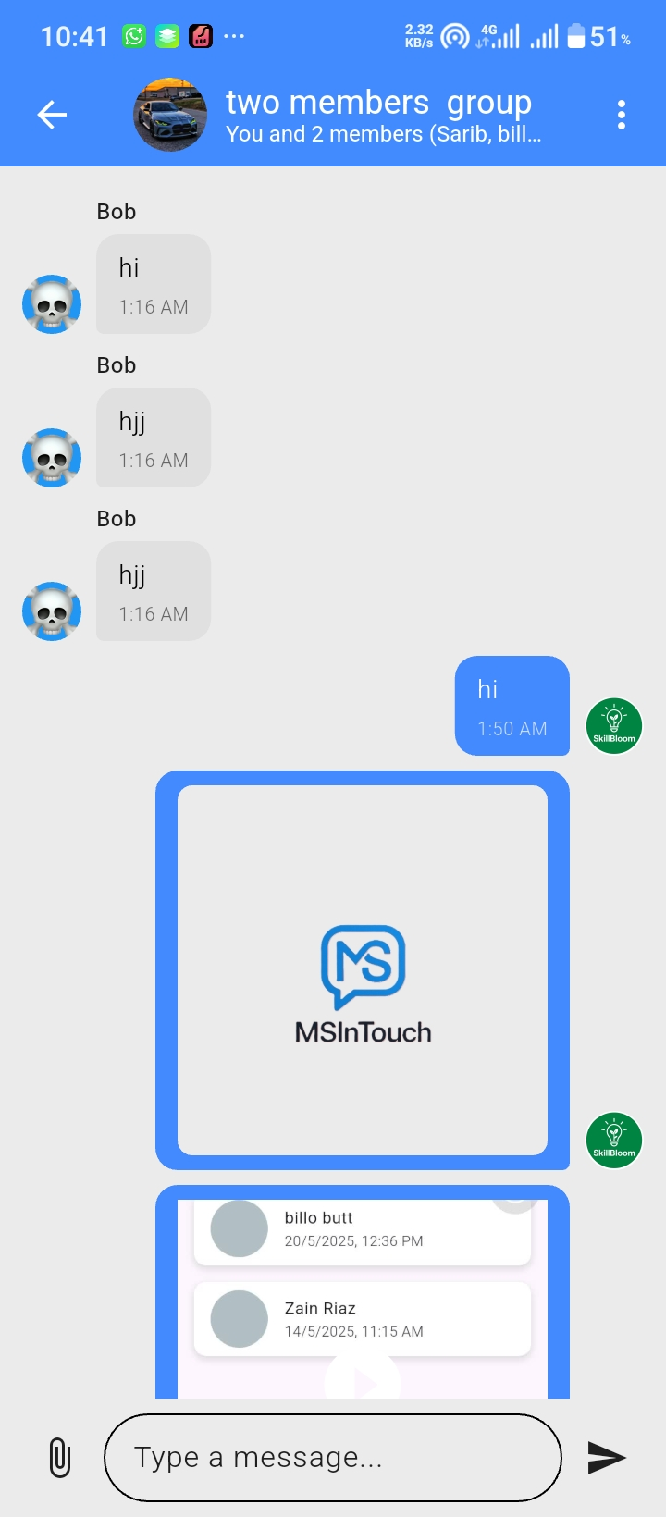
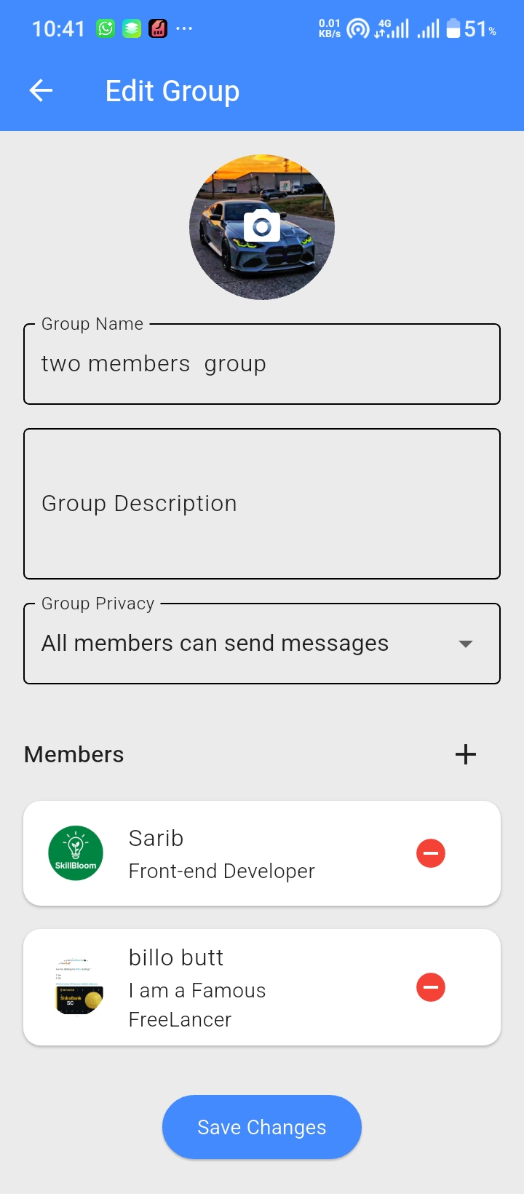
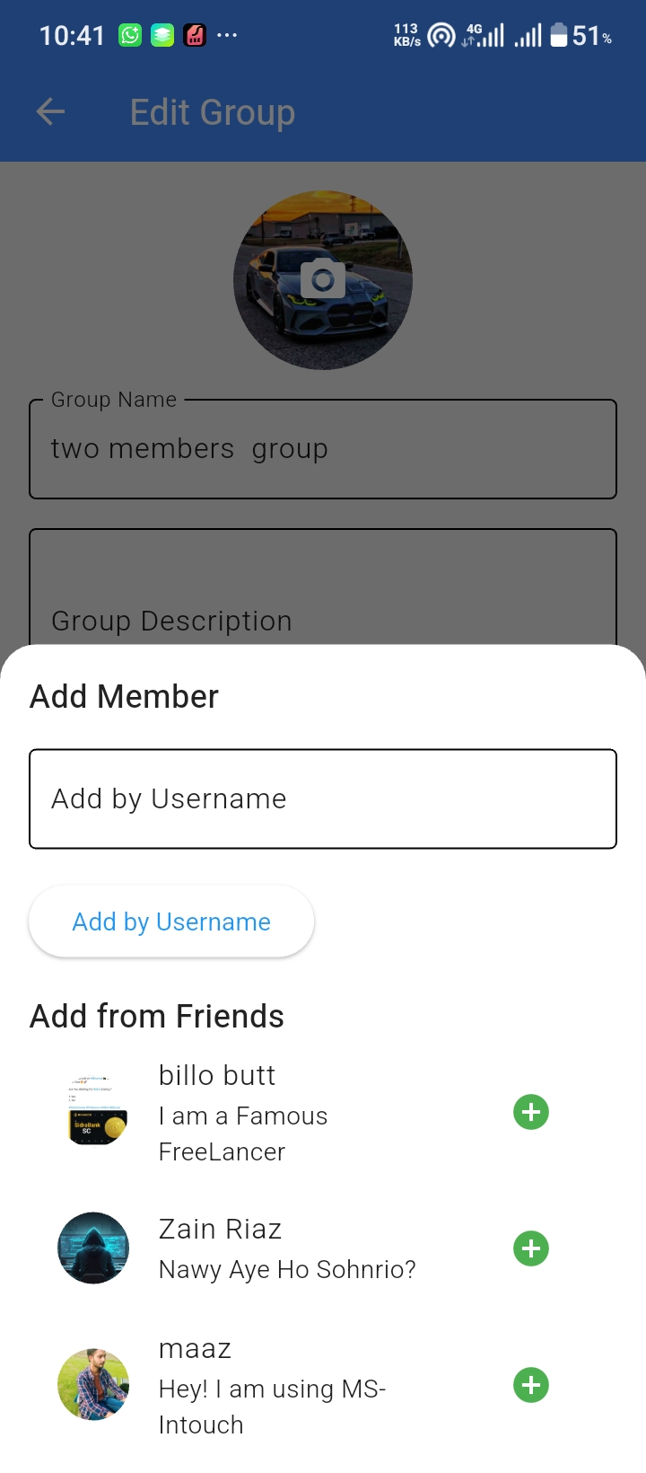
Group COnversation Screen
Group chat interface showing messages from multiple users.

Slide 14
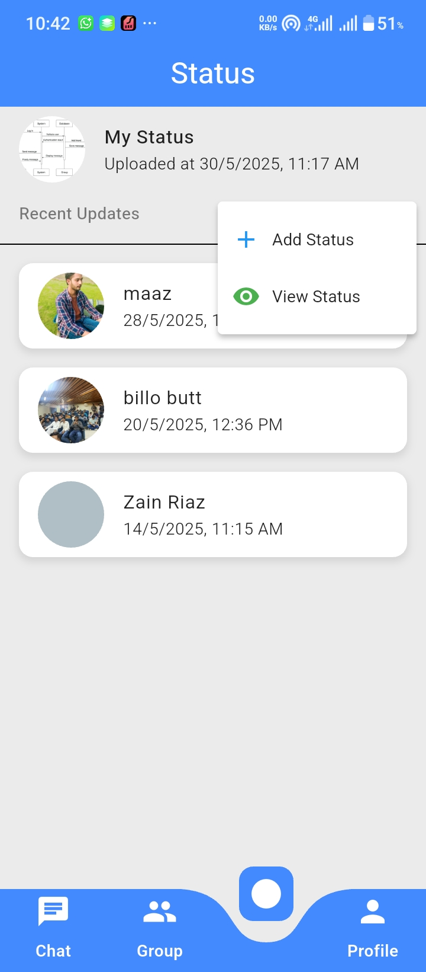
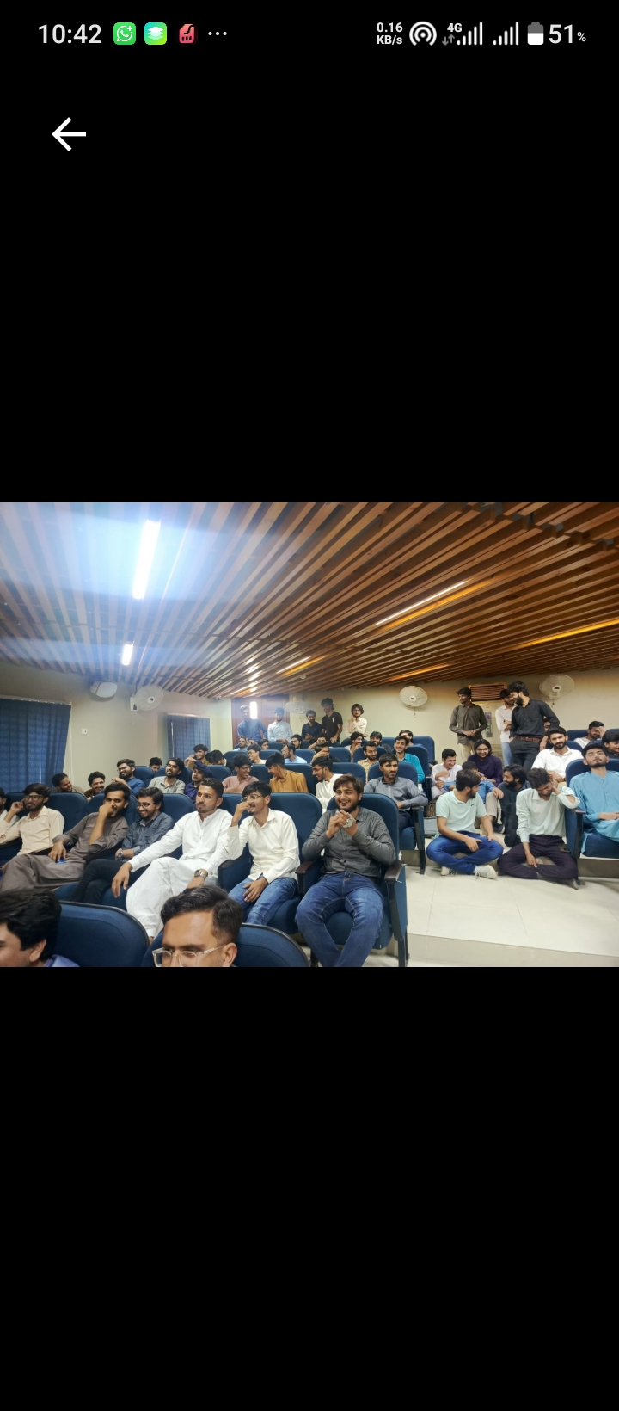
Status Screen
Lets users view and post temporary status updates like text or media.

Slide 15
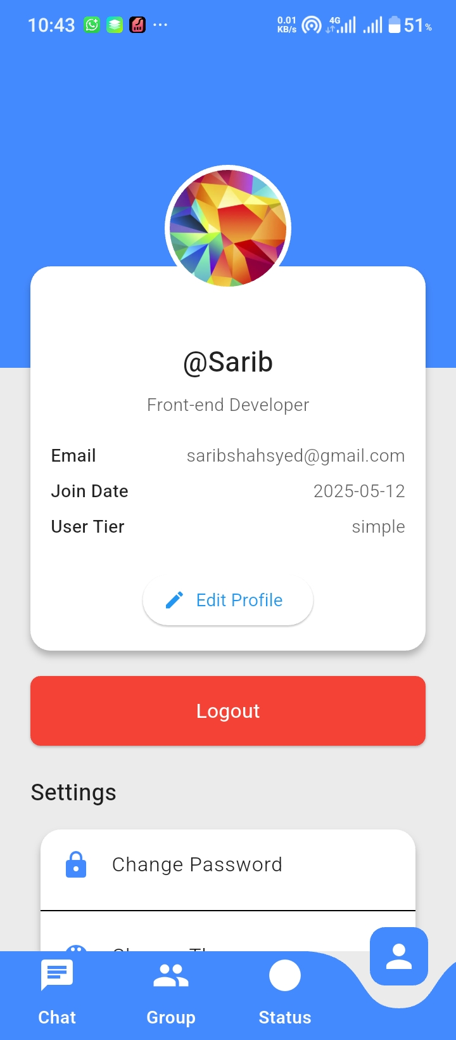
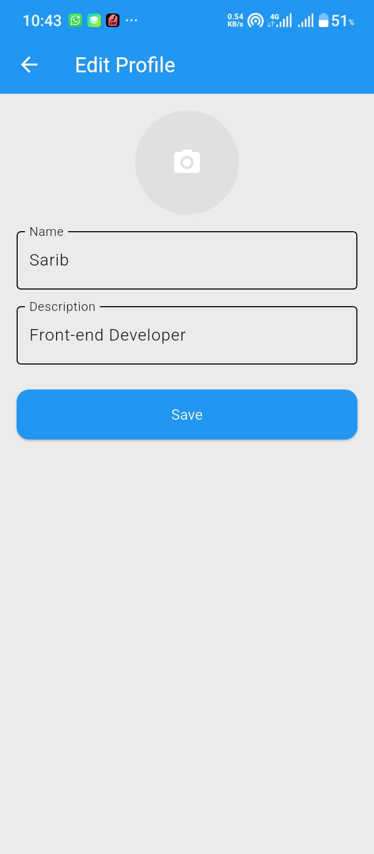
Profile Screen
User’s personal profile with options to edit name, photo, and bio.

Slide 16
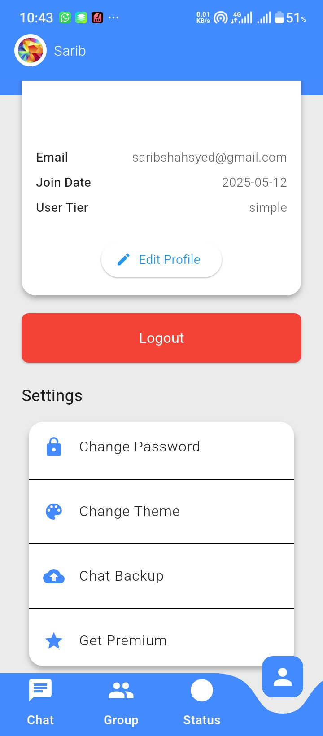
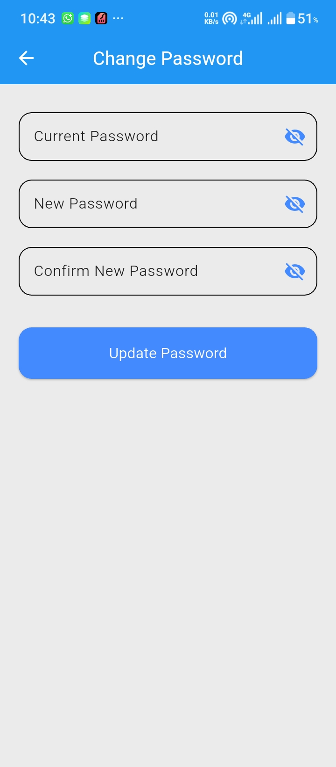
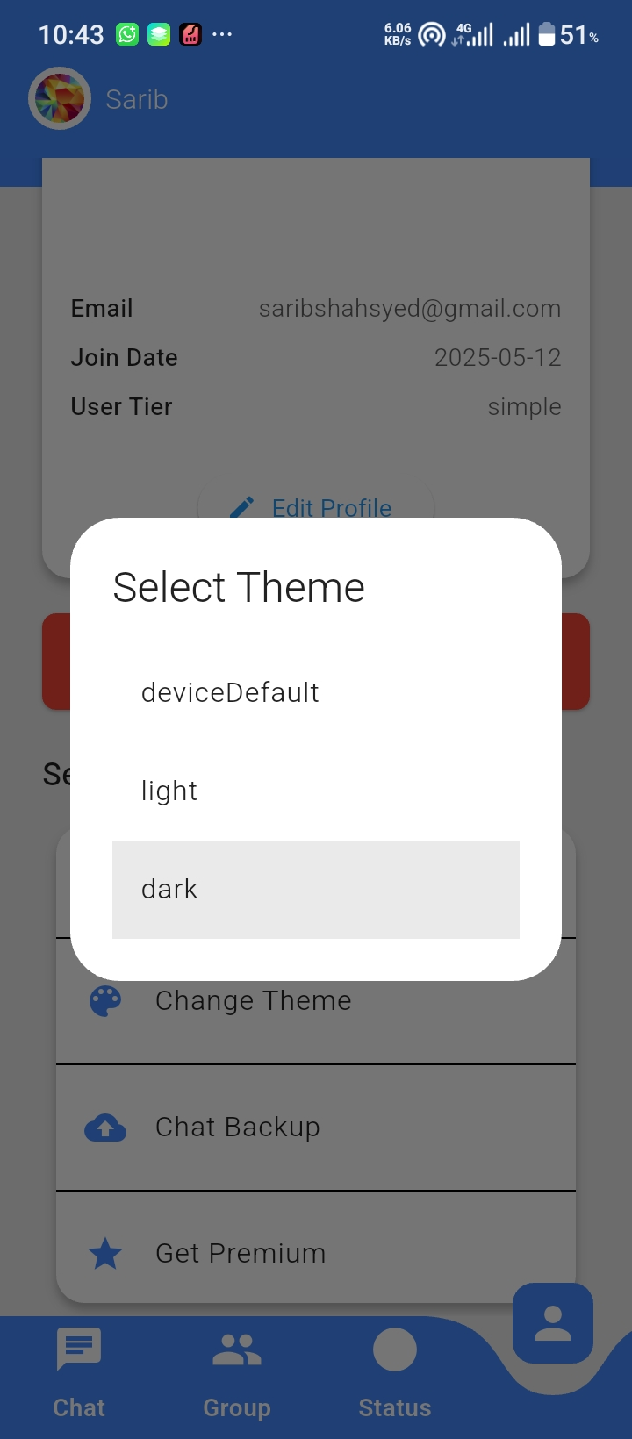
Settings Screen
May include additional settings like logout, help, etc.

Slide 17
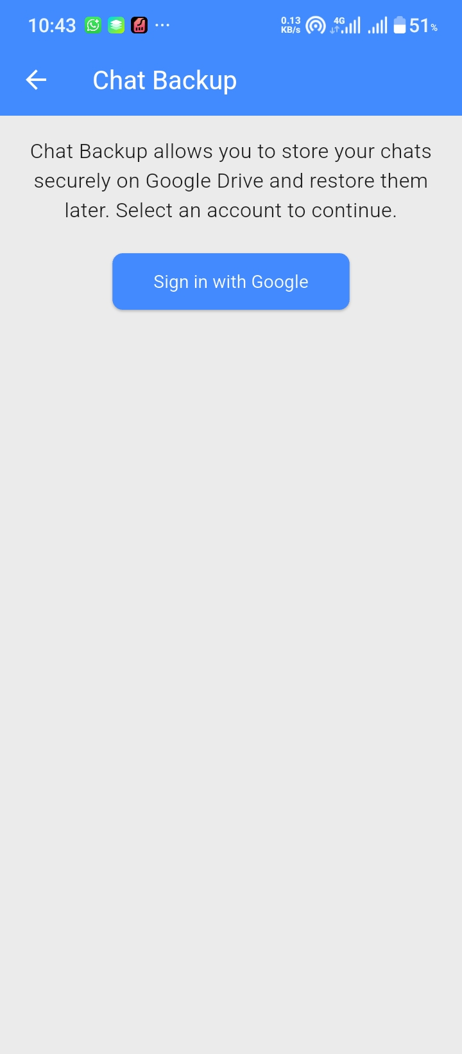
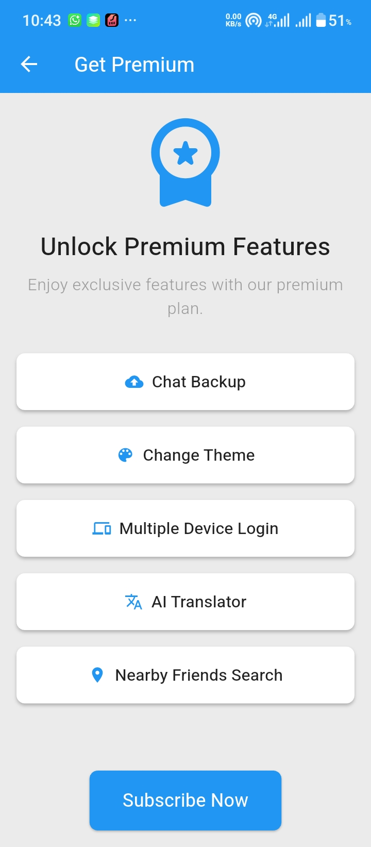
Settings Screen
Contains options to change app preferences, privacy, and notifications.

Slide 18
What We Learned
Build Cross-platform Mobile Apps
Building real-time apps with Firebase and Firestore
Managing media (images, audio, video) using Cloudinary
Handling complex UI/UX in Flutter
Implementing secure authentication and chat backups
Structuring scalable data models for chats and groups

Slide 19
Future features
AI Language Translator ( Google Translator API )
Near By Search ( geolocator )
Allow Users to add/ Customize their complete app theme

Slide 20
Thank You

